Slide 1
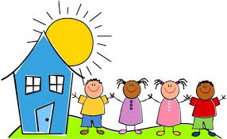
Going Back to School After Corona Virus

Slide 2
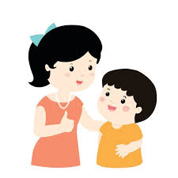
Soon I will be going back to school

Slide 3
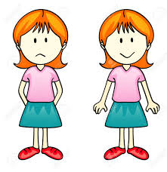
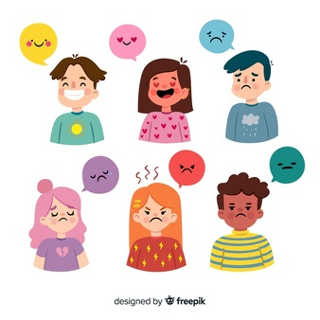
I might have a lot of different feelings right now but that is okay
I am excited but also a little bit sad
_______________

Slide 4
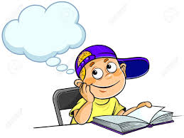
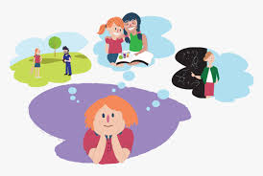
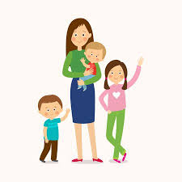
I have missed playing with my friends and seeing my teachers But I like being at home with my family too

Slide 5
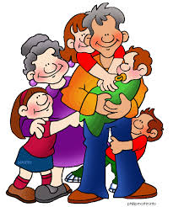
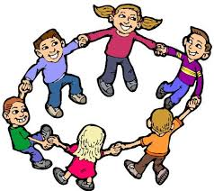
It will be fun being back with my friends and teachers I also love being with my family all day long

Slide 6
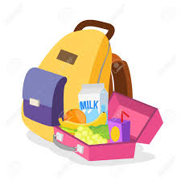
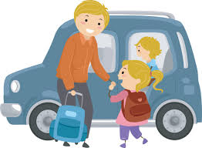
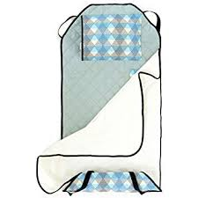
Mummy will drop me off at school and then pick me up again I will use my backpack and my lunchbox

Slide 7
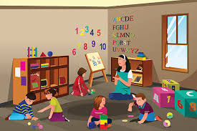
My teachers and friends will be there All the toys and books and games will be in my classroom just like they were before
DHHS-Early Childhood Services

Slide 8
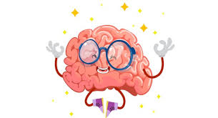
It will be strange not being at home with my family all day but I need to go to school so that I can learn and make my brain smart

Slide 9
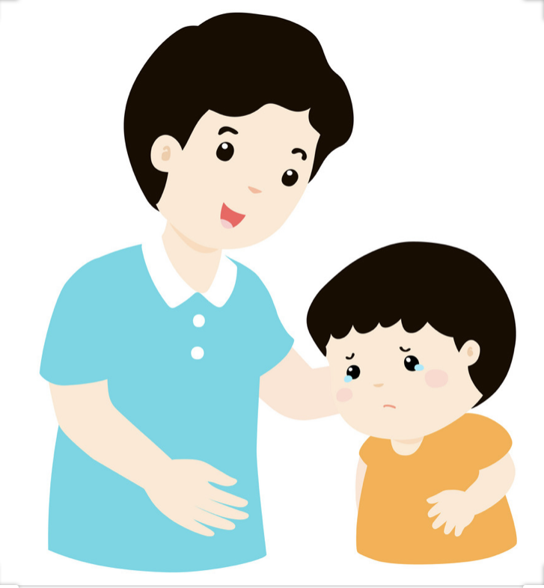
I like playing with my friends I like seeing my teachers

Slide 10
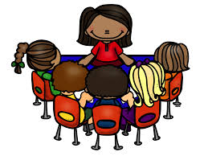
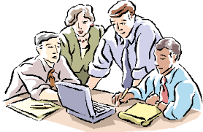
Children can go back to school and grown-ups can go back to work This makes everyone happy

Slide 11
My family loves me My teachers love me My friends will be excited to see me

