Slide 1
Background
- created as an ‘off-the-peg’ piece of bite-sized training for ‘SEMH Champions’ in Dover District to take back and cascade to staff in their schools (following a ‘train-the-trainer network/CPD session where Champs were walked through the presentation and resources).
- content largely based on the recent KCA (Kate Cairns Associates) ½-day ‘trauma-informed practice’ workshops funded by KCC with the aim of developing trauma informed practice across the county for practitioners and leaders working at the front line with children and young people.
Aims
raise awareness of the impact of trauma on childhood development
staff to reframe the way they think and act and the language they use in light of this knowledge and understanding
encourage reflection on our part in the outcomes / prognosis for more vulnerable learners (part of the problem or part of the solution?)
Note
- naturally, people are free to adapt further as they see fit but please be sure to acknowledge the KCA slides and supplementary resources
Health warning?
- given the subject matter, it might be a good idea to offer people the standard ‘emotional opt-out’ if they feel uncomfortable at any point for whatever reason
Notes:
N.B. the beauty (sic) of ‘ACEs’ as a vehicle to develop the understanding of staff teams in relation to trauma in particular - but also vulnerable learners more generally - is that it is highly memorable as a phrase (short, catchy, oxymoronic) and has a powerful and easy-to-grasp to mathematical logic.
However, need to bear in mind the following pitfalls/difficulties:
the list of ACEs can become a tick-box exercise → how many do you have?!
a tendency to focus on the experiences rather than the traumatic impact of the experiences
And the same holds true when we introduce the term ‘PACEs’ (Protective and Compensatory Experiences) → yes, ‘ACES and PACEs’ is doubly memorable / catchy given the rhyme but, again, there is a temptation to get stuck in lists, tick-boxes and the calculus of tragedy

Slide 2
ACEs & Trauma Informed Practice
School Name
Date
Presenter(s)
Notes:
Depending on the audience, start by asking who has heard of the term ‘ACEs’ + does anyone know what it stands for? = Adverse Childhood Experiences
Trauma Informed Practice - a bit of a buzzword currently and slowly but steadily gaining traction → e.g. Trauma Informed Schools website (Margot Sunderland) + recent KCA TIP workshops for Kent staff working with CYP + KEPS Senior EP, Andy Heather, at recent SEMH Conference (Nov 19)…
Could link to Local Area SEND Ofsted/CQC Report re “The variable quality of provision and commitment to inclusion in schools…” → corresponding focus in the Local Authority’s Written Statement of Action
Andy Heather’s question: could an understanding and appreciation of ACEs (and attachment) enable/empower a school towards a more inclusive culture?
Either way, the aim of this presentation is to get people to reframe the way they think and act and the language they use + what is their part in the outcomes / prognosis for our more vulnerable learners – am I part of the problem or part of the solution?

Slide 3
Activity:
In pairs/small groups, discuss ‘what is stress?’
Notes:
The aim of this activity is to get people engaged and in the zone → simply gather feedback, accept all ideas and respond encouragingly → the key point to be made is that stress involves real physical changes in the body including the release of stress hormones, in particular cortisol (→ see next slide)
N.B. The physiological response is very complex and it is unhelpful to get bogged down in excessive science. However, the following maybe useful for presenters:
“At the most basic level, stress ins our body’s response to pressures for a situation or life event…” https://www.mentalhealth.org.uk/a-to-z/s/stress
“When a stressor is perceived and interpreted, the stress response system starts up a cascade of biological events. As a result, we release the stress hormones adrenaline and cortisol…” https://humanstress.ca/stress/what-is-stress/biology-of-stress/
“The “fight-or-flight” response is responsible for the outward physical reactions most people associate with stress including increased heart rate, heightened senses, a deeper intake of oxygen and the rush of adrenaline. Finally, a hormone called cortisol is released, which helps to restore the energy lost in the response… Stress takes a variety of forms. Some stress happens as the result of a single, short-term event — having an argument with a loved one, for example. Other stress happens due to recurring conditions, such as managing a long-term illness or a demanding job. When recurring conditions cause stress that is both intense and sustained over a long period of time, it can be referred to as “chronic” or “toxic” stress. While all stress triggers physiological reactions, chronic stress is specifically problematic because of the significant harm it can do to the functioning of the body and the brain.” https://www.tuw.edu/health/how-stress-affects-the-brain/

Slide 4
What is stress?
Our physiological response as an organism to any challenge
Three levels of stress
Healthy/positive stress – everyday challenges
Stress response regulated, body and brain toned up for action
Tolerable stress – prolonged and/or excessive
Effortful management of stress response, depletes resources
Toxic stress – overwhelming experiences
Stress response unregulated, survival but at a cost
Notes:
Confirm that stress is a natural physiological/chemical reaction in our bodies → talk through the 3 levels ideally with some relevant/personal examples…
e.g. about to deliver training and laptop isn’t showing on the big screen! → rationally calm self down and trouble shoot
e.g. a 2-day Ofsted inspection or revising for finals at university - tolerable, yes, but exhausting! → Q: ask the audience what they do to ‘buffer’ their stress? ☺
in effect, an ‘overdose’ situation – we survive but at a cost, a measurable impact on our brains → q.v. an acquired brain injury (see What is trauma? slide)
https://www.tuw.edu/health/how-stress-affects-the-brain/

Slide 5
Toxic stress and trauma in childhood
Human beings are not born able to regulate stress
Most children will experience overwhelming stress at some point in childhood
Co-regulating adults can mitigate the stress and prevent injury
Research published in The Lancet Psychiatry (2019) showed in a representative sample of 18-year-olds
1 in 3 had experienced trauma in childhood – toxic stress leading to injury
1 in 12 met the diagnostic criteria for post traumatic stress disorder (PTSD) – a clinically significant level of distress affecting everyday life
Notes:
- we develop the ability to regulate stress → a primary function of parents is to help their child to learn to manage their arousal…
Q: how do we feel when a baby cries? → Yes, stressed! → we are designed to connect, mirror* and match with others…
- key point to make = we have to regulate ourselves first before we can then co-regulate the infant/child
------------------------------------------------------------
*mirror neurons - “A mirror neuron is a neuron that fires both when an animal acts and when the animal observes the same action performed by another. Thus, the neuron "mirrors" the behaviour of the other, as though the observer were itself acting.” (Wikipedia)… N.B. again, you can choose how much ‘science’ you choose to throw in

Slide 6
What is trauma?
Trauma means injury
In the context of recent research on brain function, trauma has a specialised meaning – it means acquired brain injury as a result of unregulated stress
Usually stress is good for us – when we can regulate stress it enables us to function at our best
When for any reason we are not able to regulate stress the overdose of stress hormones is toxic to the brain
Toxic stress is the signal to the brain that we are under threat
All functions that take time automatically close down
Changed blood supply to key brain areas leads to lasting injuries from which we then need to recover
Trauma is a normal part of human life
Notes:
chronically high cortisol levels can cause damage and cell death in the brain and can even reduce the size of the brain
acquired brain injury – we clearly wouldn’t blame a child who suffered a brain injury as a passenger in a traffic accident and which resulted in either intellectual and/or behavioural difficulties, etc. → vital that we, as staff working in schools, do not revictimise children who have been exposed to toxic stress through no fault of their own

Slide 7
What causes stress to become toxic?
Two key factors:
The nature of the stressor
Our vulnerability or resilience – on that day at that time
Some stressors are so severe that almost anyone will be injured by them…
…some people are so vulnerable that almost any stress can injure them
Notes:
This slide can be dealt with quickly (or even skipped?)…
- if using, then you could feed in examples and/or invite the audience to feed in (e.g. being chased by a lion vs. being yapped at by a small dog)
- in short, everyone is different and, metaphorically speaking, “one person’s meat, is another person’s poison” → we need to be tolerant, understanding and ‘curious’

Slide 8
Trauma and the adolescent brain
In adolescence the brain becomes more plastic, restructuring for adult life
Structures in the brain formed through early attachment relationships become very powerful neural pathways
The attachment figure is the social referencing point for the child keeping the child safe through access to the working adult brain
As these structures become more plastic, peers become the social referencing point for the adolescent and young adult
Secure (enough) people by then have developed self-regulation – they tend to form prosocial peer groups – clubs, teams, friendship groups
The peers of traumatised people are other traumatised people, and they all have impaired self-regulation – they tend to form antisocial peer groups – gangs, subculture groups
Notes:
traumatised people are drawn to other traumatised people → again, this idea of ‘mirroring’ – i.e. a neurobiological explanation for what we’ve always known
this slide could go in a number of directions and is clearly more relevant in a sense to secondary colleagues…
one point that can be made is that while we may not condone the antisocial behaviour, we do need to try to understand and support the child with - to use another current buzzword – compassion

Slide 9
ACEs (Adverse Childhood Experiences)
Definition
The term ACEs describes a wide range of stressful or traumatic experiences that children can be exposed to before the age of 18 and which are remembered throughout adulthood.
ACEs Study (CDC 1998)
Felitti and Anda – survey of more than 17,000 American adults – 8 ACEs initially – similar large-scale studies in other countries, more ACEs added
Findings
These experiences are cumulatively linked to:
risky health behaviours
poor academic performance / life potential
anti-social / criminal behaviour
chronic health conditions & mental illness
early death
Notes:
Felitti and Anda (1997) from the Centre for Disease Control and Prevention (CDC) surveyed 17,000 American adults
Similar large scale UK studies (e.g. in Wales in 2015) but also Canada, China, Romania, Norway, etc.
8 ACEs initially identified, later studies added more ACEs
The original ACE Study was conducted at Kaiser Permanente from 1995 to 1997 with two waves of data collection. Over 17,000 participants from Southern California receiving physical exams completed confidential surveys regarding their childhood experiences and current health status & behaviours.
The original study questions have been used to develop a 10-item screening questionnaire.
CYP who experience stressful and poor quality childhoods are more likely to develop health-harming and anti-social behaviours, perform poorly in school, be involved with crime and ultimately are less likely to be productive members of society.
Nadine Burke Harris – negative experiences that are “so severe or pervasive that they literally get under our skin and change our physiology” – TED Talk How childhood trauma affects health across a lifetime (https://www.youtube.com/watch?v=95ovIJ3dsNk)

Slide 10
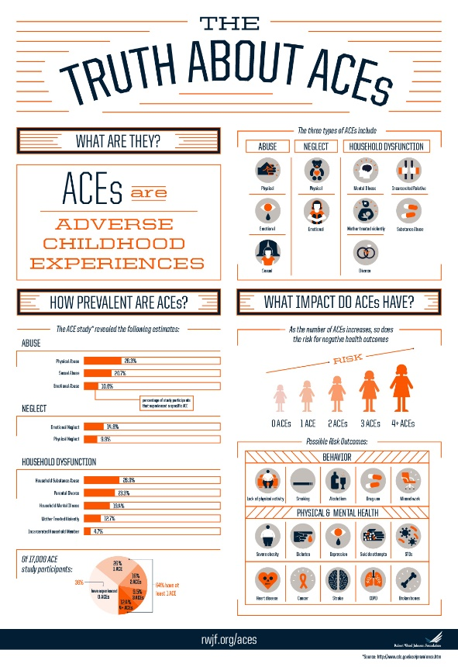
ACEs (Adverse Childhood Experiences)
Physical abuse
Sexual abuse
Emotional/verbal abuse
Physical neglect
Emotional neglect
Mother treated violently
Household substance abuse
Household mental illness
Parental separation or divorce
Incarcerated household member
Copyright 2013. Robert Wood Johnson Foundation. Full infographic is available at: www.rwjf.org/en/library/infographics/the-truth-about-aces.html
Notes:
ask the audience to shout out what they think the ACEs are…. then reveal the list → any missing? (e.g. death of a parent/close family member) + issue of homelessness / austerity & poverty / war / asylum / natural disaster
N.B. the number of possible ACEs inevitably increases as more is understood about the impact of trauma
infographic source = https://www.rwjf.org/en/library/infographics/the-truth-about-aces.html
-------------------------------------------------------------------------------------------
DfE’s Mental health and behaviour in schools (Nov 18, p18) lists 4 sub-types of ACE

Slide 11
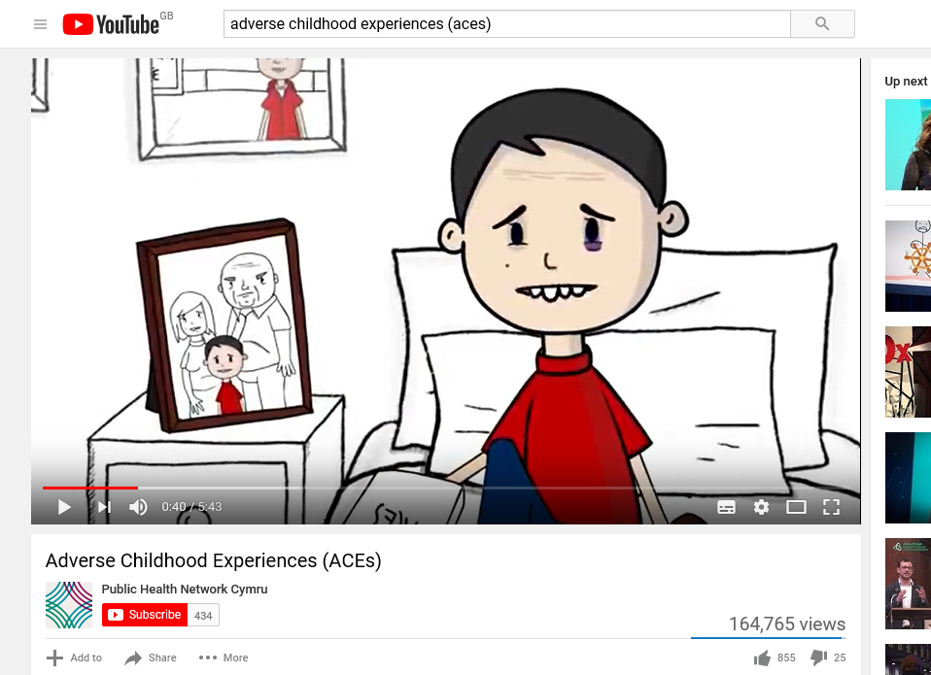
5m 43s
Notes:
Video [5 mins 43 secs] https://www.youtube.com/watch?v=XHgLYI9KZ-A
The video is short, powerful, ties everything together at this point and basically speaks for itself – no watching task as such but could ask people to feedback their thoughts after seeing it
Briefly introduce by saying something about Public Health Wales – i.e. they have committed to addressing ACEs and their impact in Wales by (i) training everybody (i.e. all public services) in the “trauma model” so they can respond effectively to prevent and mitigate the harms from ACEs and (ii) by building protective factors and resilience in the population to cope with ACEs that cannot be prevented
compassion is at the forefront of this – i.e. how we interact with this group
soundbite - the adult is the child in disguise / “The Child Is Father of the Man” (Wordsworth)
-----------------------------------------------------------------------
Highly recommended for your own CPD = Dr Mark Bellis’s Presentation on Adverse Childhood Experiences, Resilience and Equity https://www.youtube.com/watch?v=7xuWzPRf0ro [29 mins 58 secs]

Slide 12
ACEs scores and risk
ACEs are common – 64% of adults have at least one…
ACEs tend not to occur alone – if you have one, there’s an 87% chance of having 2 or more…
The more ACEs you have, the greater the risk of adverse outcomes…
Mental health issues
Chronic health problems
Risky behaviours
Notes:
The (original) ACE Study revealed six main discoveries:
1) ACEs are common…nearly two-thirds (64%) of adults have at least one.
2) They cause adult onset of chronic disease, such as cancer and heart disease, as well as mental illness, violence and being a victim of violence
3) ACEs don’t occur alone….if you have one, there’s an 87% chance that you have two or more.
4) (cumulative) The more ACEs you have, the greater the risk for chronic disease, mental illness, violence and being a victim of violence. People have an ACE score of 0 to 10.
N.B. the link for the online ACE Quiz is https://www.npr.org/sections/health-shots/2015/03/02/387007941/take-the-ace-quiz-and-learn-what-it-does-and-doesnt-mean - quite powerful to do this, either for yourself or with a child in mind (what do I know about their life story, and what might I not know?)
-----------------------------------------------------------------
Based on large populations - the more ACEs experienced, the worse the outcomes.
But research shows that future outcomes for health and wellbeing are NOT prescribed by past experience → PACEs (Protective and Compensatory Experiences)

Slide 13
Statistically speaking…
UK study suggests those with 4 ACEs + are:
2x more likely to have a poor diet
3x more likely to smoke
5x more likely to have had sex under 16
7x more likely to be alcoholic
10x more likely to inject drugs
11x more likely to have been incarcerated
12x more likely to attempt suicide
Source: Bellis et al. 2012, 2013, 2014
Notes:
People with high ACE scores are more likely to be violent, to have more marriages, more broken bones, more drug prescriptions, more depression, and more autoimmune diseases. People with an ACE score of 6 or higher are at risk of their lifespan being shortened by 20 years. https://acestoohigh.com/aces-101/
On a population level, it doesn’t matter which four ACEs a person has; the harmful consequences are the same. The brain cannot distinguish one type of toxic stress from another; it’s all toxic stress, with the same impact. https://acestoohigh.com/aces-101/
Key point = the huge personal cost to the individual, their family, the community and to society/us as tax payers – and hence of course the public health angle
Based on large populations - the more ACEs experienced, the worse the outcomes.
But research shows that future outcomes for health and wellbeing are NOT prescribed by past experience → PACEs (Protective and Compensatory Experiences)
N.B. different ACE studies yield different multipliers as they are based on different population sets but the picture is broadly the same - this slide draws on figures from https://www.towerhamlets.gov.uk/Documents/Children-and-families-services/Early-Years/ACES_and_social_injustice_DCP_SW.pdf

Slide 14
Statistically speaking…
People with an ACE score of 6 or higher are at risk of their lifespan being shortened by 20 years.
Notes:
People with high ACE scores are more likely to be violent, to have more marriages, more broken bones, more drug prescriptions, more depression, and more autoimmune diseases. People with an ACE score of 6 or higher are at risk of their lifespan being shortened by 20 years. https://acestoohigh.com/aces-101/
On a population level, it doesn’t matter which four ACEs a person has; the harmful consequences are the same. The brain cannot distinguish one type of toxic stress from another; it’s all toxic stress, with the same impact. https://acestoohigh.com/aces-101/
Key point = the huge personal cost to the individual, their family, the community and to society/us as tax payers – and hence of course the public health angle
Based on large populations - the more ACEs experienced, the worse the outcomes.
But research shows that future outcomes for health and wellbeing are NOT prescribed by past experience → PACEs (Protective and Compensatory Experiences)

Slide 15
PACEs Center for Integrative Research on Childhood Adversity (CIRCA) Oklahoma State University
However, research shows that future outcomes for health and wellbeing are NOT prescribed by past experience…
Notes:
moving beyond / away from the deterministic…
Research shows that future outcomes are not prescribed by past experience but depend in part on individual resilience as well as the environment and relationships
and which brings us to PACEs - something likely to be new to (most) of the audience → show of hands again, etc.
yes, ‘ACES and PACEs’ – again, even more memorable / catchy but…
ACEs list can become a tick box exercise – how many do you have?! And for PACEs, too.
Focus on the experiences rather than the traumatic impact of the experiences
http://circaok.com/uploads/3/6/3/2/36326591/2019_jhg_paces_poster_1.jpg
Large populations studies have established a predictive relationship between ACEs and subsequent adult health and behaviour.
We argue that research on the effects of ACEs should also include environmental conditions and relationships that mitigate the neurological impairments associated with ACEs.
We identified 10 PACEs and have developed a parallel survey with 10 ‘yes’ or ‘no’ items.

Slide 16
PACEs Center for Integrative Research on Childhood Adversity (CIRCA) Oklahoma State University
Protective & Compensatory Experiences
Connectedness/Belonging | Structure/Predictability
Had someone who loved them unconditionally | Had an engaging hobby
Had at least one best friend | Went to a school with the resources & activities necessary for learning
Regularly did something to help others alone or as part of a group | Lived in a home with enough food and was typically clean and safe
Had access to a trusted adult (not a parent) to turn to | Was involved in an organised sports group or other physical activity
Was active in at least one civic or non sport social group | Lived in a home where rules were clear and fairly administered
Notes:
Hopefully, something new to (most) of you – and, indeed, moving beyond statistically to what we can do to avoid and/or mitigate the impact of ACEs…
trusted adult = key to buffering the child’s stress – q.v. co-regulation
Begs the Q: which of these can we influence, what do we do already, what else can we do? And what can others do?
GET A SCHOOL DOG! ☺
clearly, difficult for one service alone to provide these things → hence the need for a multi-agency approach and a common understanding
And in terms of structure/predictability → consistency and fairness of our responses – i.e. all staff → policies to enable / ensure this + the awareness and understanding of all staff → so, what do they need to know in terms of how these children are affected by trauma?
http://circaok.com/index.html
Center for Integrative Research on Childhood Adversity (CIRCA) – Oklahoma State University

Slide 17
OK, I get that this stuff really matters and that we, as school staff, have a responsibility to make sure we’re part of the solution…
So what else do I need to be aware of and thinking about?
Notes:
ask the Champion, is this slide unnecessary for their staff? Obviously, it can easily be omitted…
this stuff really matters → yes, literally a matter of life and (premature) death!!

Slide 18
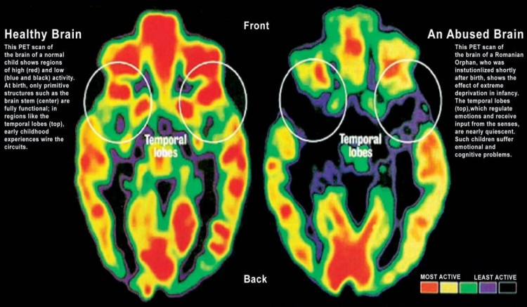
Notes:
And is this slide too much for the audience/time available?
1) Early Life Experience and the Brain - taken from Mark Bellis’s Presentation on ACEs, Resilience and Equity https://www.youtube.com/watch?v=7xuWzPRf0ro [1:45-2:54] – tape script to go with the fight-flight graphics:
- this is a (sort of) pathway people are familiar with… it’s a fight-flight response (babies and toddlers can’t run away but it’s essentially the same thing happening)…
- yet get a threat and your system goes to a higher level… and then there’s a safe space and you come back down again and your body relaxes, recovers and it’s at rest
- BUT when you’re exposed to chronic stresses or ACEs, your body doesn’t come back and for very sensible evolutionary reasons, it gets set to a higher state of alert permanently…
- but that has a lot of consequences, the first one being a health one which I’ll onto in a while - if you set any system to a higher state of alert, it wears out quicker and that’s fundamentally one of the things that’s happening… → i.e. premature death
- but it also means that people who’ve been exposed to ACEs are more likely to see neutral faces as threatening faces and that give us a criminal justice issue and a violence issue… and when they sit in school, they’re called anxious, disengaged, poor learners because they don’t think people are there to help them – they think they’re there to get them, so they don’t integrate in the same way (2.54)
2) PET scans of normal and abused brain showing damaged brain structure and function (http://keepkidssafe.org/effects-of-child-abuse/) – remember: trauma is an acquired brain injury

Slide 19
The impact of trauma
Until they recover people affected by toxic stress struggle to:
Self-regulate – stress, impulses, shame
Regulatory disorders
Process information accurately – make sense of the world around them or their own internal world of feelings
Processing disorders
Make and maintain relationships – understand and be interested in the world of others
Social function disorders
It is possible to recover from these disorders
Restoring integrated function actually builds resilience
We grow stronger through recovery from toxic stress
Notes:
In short, chronic levels of toxic stress (cortisol) can injure our brains, changing the way we think, feel and behave until we have recovered from the injuries.
(However) “It is possible to recover” – yes, the brain is plastic (not mature until at least mid-20s) → important that we do NOT give up on these children/write them off
The next 3 slides expand on the 3 main problem areas identified – regulation. processing and social functioning → as far as possible, keep things concrete by relating this to your own school context
Needless to say, the point to bear in mind is that these children (likely to be a significant minority) should not be seen as ‘choosing’ to behave/present in these dysfunctional ways any more so than a person whose personality/behaviour has changed as a result of a head injury

Slide 20
Reduced ability to self-regulate
Regulatory disorders – challenging behaviour
Stress
Hyperarousal: panic, rage, aggression, impaired memory, etc. …
… and/or dissociation: switched off, avoidant, controlling, etc. …
May be, or be seen as, antisocial behaviour, offending behaviour, harmful behaviour, self-harming behaviour etc …
Impulse
Impaired ability to manage or account for behaviour
Not able to benefit directly from rewards and sanctions
Shame
Hypersensitive to criticism or praise, or apparent lack of remorse
Notes:
Option: before looking at this slide, could ask people in pairs/groups to briefly discuss ‘How do you feel when you’re really anxious/angry?’ → gather feedback and establish that higher order functioning is impaired (impossible?) when you’re stressed/worried/wound up/etc. → now imagine that your brain-body is permanently in this state, how successful do you think you would be socially/professionally?!
Q: And does any of this sound like any other diagnoses? ADHD?

Slide 21
Reduced ability to make sense of the world
Processing disorders – impaired understanding
The world around them
Difficulty making sense of sensory information
hot or cold, hungry or full, tired or energetic, comfortable or in pain (or locating where in the body any pain might be)
Self-harming behaviours may become patterned/triggered responses to this disruption of function
Misunderstanding or misrepresenting everyday events and experiences
Their inner world
Difficulty making sense of feelings in self or others
Not able to put feelings into words
Notes:
- e.g. misinterpreting another pupil’s smile as mocking…
→ Mark Bellis’s point that people who’ve been exposed to ACEs are more likely to see neutral faces as threatening faces… when they sit in school, they’re called anxious, disengaged, poor learners because they don’t think people are there to help them – they think they’re there to get them, so they don’t integrate in the same way

Slide 22
Reduced ability to make sense of social interaction
Social function disorders – social exclusion
Understanding others
Difficulty with empathy: processing incoming information about the emotional state of other people
Reduced motivation, and ability, to engage positively with others
Anhedonia
Loss of the capacity for joy
Reduced or impaired ability to remember joyful experiences
Feelings of worthlessness
Difficulties with self-esteem
Global sense of shame triggered by minor events
Notes:
Anhedonia: Loss of the capacity to experience pleasure. The inability to gain pleasure from normally pleasurable experiences. Anhedonia is a core clinical feature of depression, schizophrenia, and some other mental illnesses. An anhedonic mother finds no joy from playing with her baby. ☹

Slide 23
???
Notes:
A starting point (words matter!)… “Reframing thoughts about a young person” (KCA exercise)
simply read through the blurb with the group and do the example together → hand out the worksheet and ask them to do this in pairs / small groups
*How you manage yourself and how you understand the child is key*

Slide 24
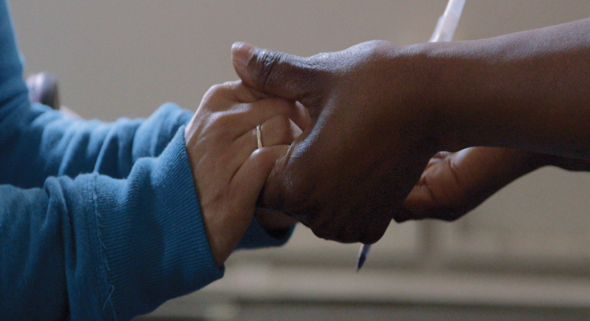
Understanding trauma is not just about acquiring knowledge. It’s about changing the way you view the world. It’s about changing the helping paradigm from ‘What is wrong with you?’ to ‘What happened to you?’ Dr Sandra Bloom (2007)
What is wrong with you?
What happened to you?
blame
shame
punishment
understanding
nurturing
healing
Notes:
as mentioned, the purpose of this session = to provide you with a presentation you can take back to cascade to get people thinking and reframe the way they think and act and the language they use – and their part in the outcomes / prognosis for our more vulnerable learners – am I part of the problem or part of the solution?
- this could be an excellent slide to conclude with (stark, powerful) + a poster to put in staffroom and loos!
- Q: how often do we hear an exasperated colleague (or even ourselves! or at least just think it) in the staff room ask, “What’s wrong with that child?!”
------------------------------------------------------------------------
“Understanding trauma is not just about acquiring knowledge. It’s about changing the way you view the world. It’s about changing the helping paradigm from ‘What is wrong with you?’ to ‘What happened to you?’” Dr Sandra Bloom (2007)
Hard to track down this much used quote – but possibly it’s from Vargas, L. A. and Bloom, S. L. (Eds) 2007. Loss, Hurt and Hope: The Complex Issues of Bereavement and Trauma in Children. Newcastle--on-Tyne, UK: Cambridge Scholars Publishing

Slide 25
Recovery and resilience
Most people, most of the time, recover from toxic stress
They swiftly self-regulate and the brain reconnects without injury
This is resilience
Most people, most of the time, recover from trauma
When injured by toxic stress, people recover and develop resilience through building and strengthening new connections in the brain
Traumatised children need adults who can enable them to:
Stabilise: self-regulate through co-regulation with the adult
Integrate: process information accurately, guided by the adult
Adapt: become socially adaptive with the support of the adult
Some people need more help to recover from these injuries
Notes:
A final, final thought…
Co-regulating involves empathy and self-regulation. It means being aware of the dysregulation in the other person because our own nervous system reacts to mirror the disruption, and then self-regulating to reduce the arousal. Since humans are born to connect, mirror and match this reduction in stress is then replicated in the other person (usually unconscious/gut level/feeling). [KCA exercises: CO-REGULATE – GUIDE – SUPPORT]
i.e. (just as with a BABY) we need to SELF-REGULATE so we can CO-REGULATE the child and, in time, they can then learn to SELF-REGULATE

Slide 26
THE END (?)
Notes:
where you choose to end depends on your audience/the time available…
more excellent materials from KCA and Beacon House to support you with discussion re next steps, etc. but - first n foremost - SLT must be on board…
final few slides will hopefully be helpful likewise in terms of whole-school priorities and direction…
either way, I hope at least some of you will take this training back to cascade to colleagues… ☺
and if I (and/or Karen) can, happy to come in and co-deliver with you

Slide 27
Trauma-informed practice and mentally health schools
“At a time when schools and teachers are exceedingly stressed and stretched, becoming trauma informed may seem an ambitious and challenging strategy. However, the rewards for everyone involved are real and energising”
(Oehlberg B, 2008)
“There is no more effective neurobiological intervention than a safe relationship, the relationship works to bring the brain back into regulation.” (Perry B, 2006)
A child, in order to feel safe at school, needs to know that they can approach any classroom teacher, specialist, SLT, HLTA, wellbeing support, or business manager and receive the same response. The response needs to be agreed upon by all staff, practiced, and with an accepted process when things don’t go the way we hope.” (Lewis M, 2017)
Notes:
as mentioned, buzz words include TIP, MHS and compassionate schools…
not surprisingly, given the original ACEs study was in the US, America is ahead of the game…
these 3 quotes are from https://www.teachertoolkit.co.uk/2017/12/05/trauma-informed/

Slide 28
Trauma-informed practice and mentally health schools
Providing vulnerable children with daily access to at least one named, emotionally-available adult, who believes in them…
Catching children as they are ‘falling’ not after they have fallen…
The implementation of a Relationship Policy (Paul Dix) for all staff to ensure they interact with children at all times with kindness and compassion…
A commitment to relating to children in a school in ways that help them feel calm, soothed and safe…
Staff interacting with all children in such a way that they feel valued as individuals throughout their day.
Staff adjusting their expectations of vulnerable children to correspond with their developmental capabilities and experience of traumatic stress.
https://www.traumainformedschools.co.uk/our-mission
Notes:
as mentioned, buzz words include TIP, MHS and compassionate schools…
not surprisingly, given the original ACEs study was in the US, America is ahead of the game…
but in the UK, Margot Sunderland is right in there! Co-director of Trauma Informed Schools UK → https://www.traumainformedschools.co.uk/ → “PASSIONATE ABOUT IMPROVING LEARNING, MENTAL HEALTH AND QUALITY OF LIFE FOR CHILDREN AND YOUNG PEOPLE”
- This slide pulls out a few of the points from their so-called ‘MISSION STATEMENT’ → handout for staff to take a look at…
Thrive as a good example of TIP in schools → current deliberate push by Thrive as an APPROACH (i.e. whole-school) rather than an intervention down-the-corridor
And Mindfullness effective – Mindfulness-Based Stress Reduction (MSBR) – recent studies show how the brain changes in both structure and function to allow increases in (1) impulse control (2) self-compassion and (3) sensory awareness. (→ KCA handout ‘ACEs and PACEs’)

Slide 29
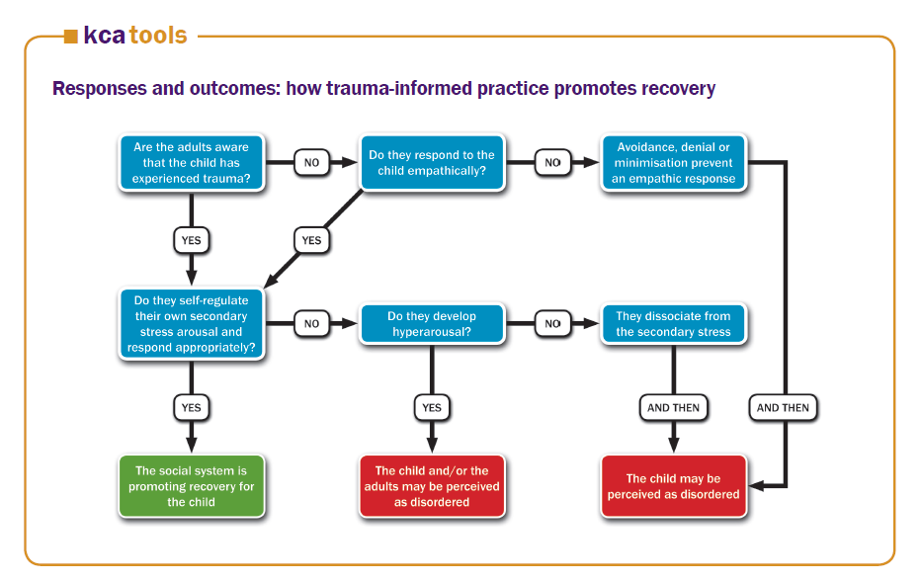
Notes:
another excellent, thought-provoking resource from KCA
for now, have a look and a think + discuss on your tables…
“Do they (the adults) self-regulate their own secondary stress arousal and respond appropriately?” → self-regulation before co-regulation
→ “The child may be perceived as disordered” – i.e. danger of MISDIAGNOSIS → Margot Sunderland article (next slide)

Slide 30
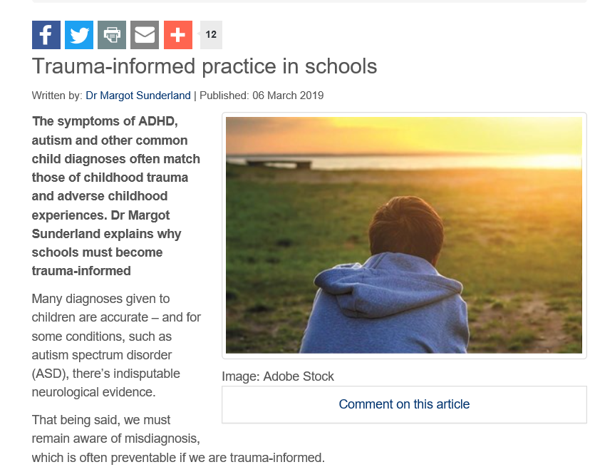
Misdiagnosis
http://www.sec-ed.co.uk/best-practice/trauma-informed-practice-in-schools/
Notes:
Margot Sunderland article (6/3/19) - http://www.sec-ed.co.uk/best-practice/trauma-informed-practice-in-schools/
- follows on perfectly from the KCA ‘Responses and Outcomes’ resource…
A good note to end on – simply give Champions a hardcopy to take away…

Slide 31
Mark Bellis
NHS England Lecture
(30 mins)
Nadine Burke Harris
TED Talk
(16 mins)
Presentation on Adverse Childhood Experiences, Resilience and Equity
How childhood trauma affects health across a lifetime
Notes:
Highly recommended!!
Mark Bellis https://www.youtube.com/watch?v=7xuWzPRf0ro
Nadine BH https://www.youtube.com/watch?v=95ovIJ3dsNk

