Slide 1
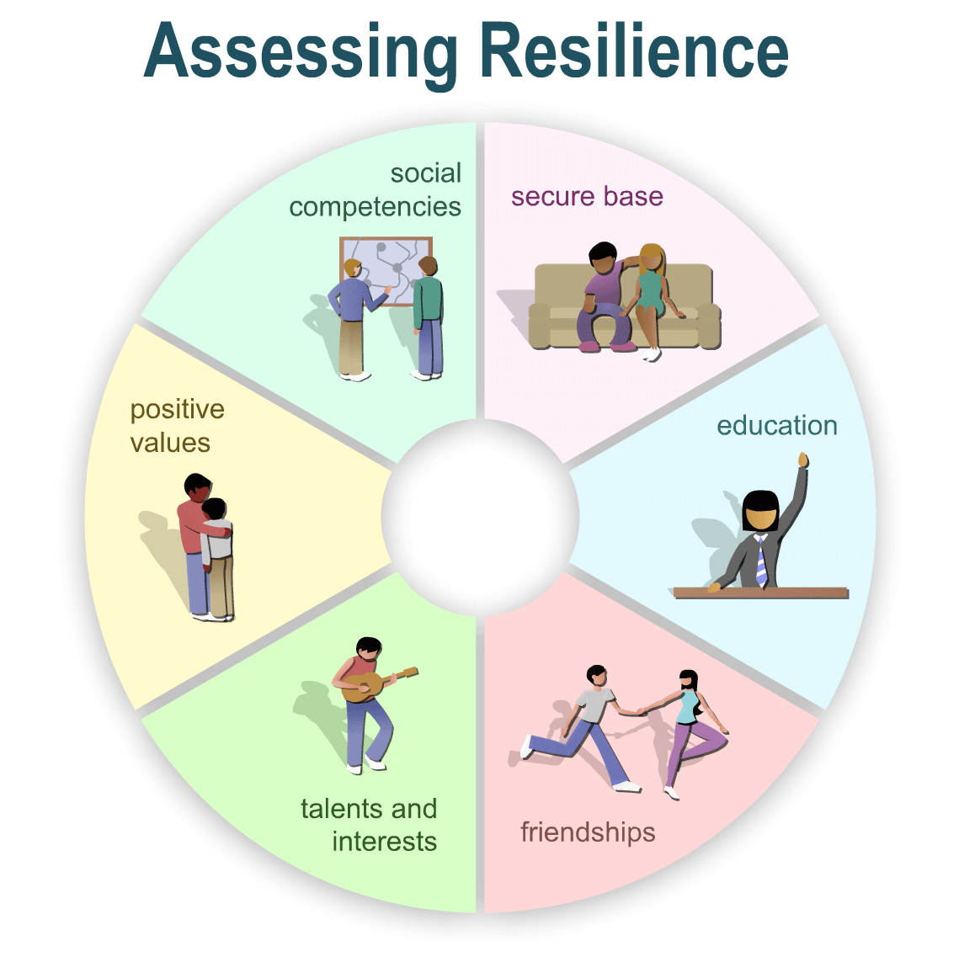
Exploring Young People’s Resilience
It is important to consider factors at all levels;
Individual Factors
Family Factors
School Community Factors
This means we can gain a realistic picture of a young person’s strengths and protective factors as well as areas for further support or skill development
This helps us to respond holistically
Headstart Framework –taken from https://www.kelsi.org.uk/__data/assets/pdf_file/0007/66166/Resilience-Toolkit-Combined.pdf

Slide 2
Social competencies
Individual: To what extent does this young person’s level of emotional literacy and social skill help him/her to maintain positive social experiences?
Family: To what extent do parents/carers encourage socialisation at home?
Community: What social opportunities does this young person have at school to extend his/her skills?
A Secure Base
Individual: Does the young person appear to feel secure and confident?
Family: Do the young person’s parents/carers provide the young person with a sense of security? What are the family relationships like?
Community: What about school helps this young person feel secure? Could more be done?
Positive values
Individual: How much does he/she understand the values of your school community? To what ability can he/she empathise with others?
Family & Community: What level of helpful or pro-social behaviours does this young person show with others?
Education
Individual: does the young person show curiosity and interest in learning?
Family: To what extent do parents support the young person’s learning at home?
Community: What opportunities are there in the wider environment to support or develop the young person’s interests or curiosity?
Friendships
Individual: What strengths does this young person have that help with making and keeping friends?
Family: To what extent do the young person’s carers support the development of friendships?
Community: What are the young person’s friendships like at the moment in school?
Talents and Interests
Individual: What talents / interests does this young person have?
Family: Do parents/carers encourage the development and expression of talents and interests?
Community: What opportunities are there in school for nurturing and celebrating these?
Notes:
Framework by HeadStart about how to assess resilience in young people
Secure base
Individual: Does the young person appear to feel secure?
Family: Do the young person’s carers provide the young person with a secure base?
Community: What are the wider resources that contribute to the young person’s attachment network?
Education
Individual: To what extent does the young person show curiosity and interest in learning, school or college?
Family: To what extent do the young person’s carers facilitate the young person’s learning
Community: What opportunities are there in the wider environment to support the young person’s learning?
Friendships
Individual: What characteristics does the young person have that help with making and keeping friends?
Family: To what extent do the young person’s carers support the development of friendships?
Community: What are the young person’s friendships like at the moment?
Talents and interests
Individual: What talents does this young person have and does she have any particular interests?
Family: Do carers encourage the development and expression of talents and interests?
Community: What opportunities are there in the wider community for the nurturing of this young person’s talents and interests?
Positive values
Individual: What level of moral reasoning does this young person show, what understanding of his or her own feelings and what ability to empathise with those of others?
Family: What level of helping behaviour does this young person show?
Community: What level of comforting or sharing or more general pro-social behaviour does this young person show?
Social competencies
Individual: To what extent do this young person’s personal characteristics contribute to his or her level of social competence?
Family: To what extent do carers encourage social competencies?
Community: What opportunities does this young person have to develop competence in a wider social environment?

Slide 3
Social competencies
Individual:
Family:
Community:
[CYP NAME]
A Secure Base
Individual:
Family:
Community:
Positive values
Individual:
Family & Community:
Education
Individual:
Family:
Community:
Friendships
Individual:
Family:
Community:
Talents and Interests
Individual:
Family:
Community:
Notes:
Framework by HeadStart about how to assess resilience in young people
Secure base
Individual: Does the young person appear to feel secure?
Family: Do the young person’s carers provide the young person with a secure base?
Community: What are the wider resources that contribute to the young person’s attachment network?
Education
Individual: To what extent does the young person show curiosity and interest in learning, school or college?
Family: To what extent do the young person’s carers facilitate the young person’s learning
Community: What opportunities are there in the wider environment to support the young person’s learning?
Friendships
Individual: What characteristics does the young person have that help with making and keeping friends?
Family: To what extent do the young person’s carers support the development of friendships?
Community: What are the young person’s friendships like at the moment?
Talents and interests
Individual: What talents does this young person have and does she have any particular interests?
Family: Do carers encourage the development and expression of talents and interests?
Community: What opportunities are there in the wider community for the nurturing of this young person’s talents and interests?
Positive values
Individual: What level of moral reasoning does this young person show, what understanding of his or her own feelings and what ability to empathise with those of others?
Family: What level of helping behaviour does this young person show?
Community: What level of comforting or sharing or more general pro-social behaviour does this young person show?
Social competencies
Individual: To what extent do this young person’s personal characteristics contribute to his or her level of social competence?
Family: To what extent do carers encourage social competencies?
Community: What opportunities does this young person have to develop competence in a wider social environment?

Slide 4
For a child to become more resilient we need to build their sense of:
Belonging
(sense of connectedness and being accepted)
Belief in own their strengths and abilities (self-esteem)
Emotional security (attachment)
Notes:
Ask ELSAs to remember back to their discussions about friendship groups and what you could do to support the development of belonging and social acceptance. They had small group discussuins with other for this.
Attachment was covered in detail in the summer, and strengths and abilities.
This short session will look at social belonging and two activities/interventions that could be introduced to improve this.
Recap on:
What does your school do already to support developing friendships and sense of belonging?

Slide 5
Why is Belonging important?
“Generally, for a child to flourish and achieve in school they need to feel that they belong and are a valued part of the school community.
School belonging (or “school connectedness”) involves feeling ’personally accepted, respected, included, and supported by others in the school social environment”
(Goodenow, 1993)

Slide 6
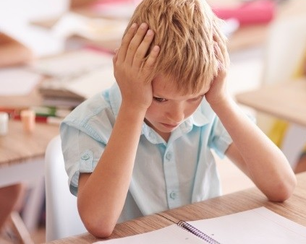
Developing School Belonging & Friendships Circle of Friends - Who Might Benefit?
Children who are experiencing…
…Name calling, Teasing or Bullying
…Difficulties at lunch and break time
…Poor relationships with others
Children who we would like to…
…Learn to cope with their feelings
…Use appropriate language
…Take part in lessons
…Learn how to say ‘no’
Children who find it difficult to…
…Make new friends
…Take Turns
…Listen to others
…Recognise others’ feelings

Slide 7
Ben’s Circle of Friends
https://www.youtube.com/watch?v=jHtWDNmaC_E
13mins

